Slide 1
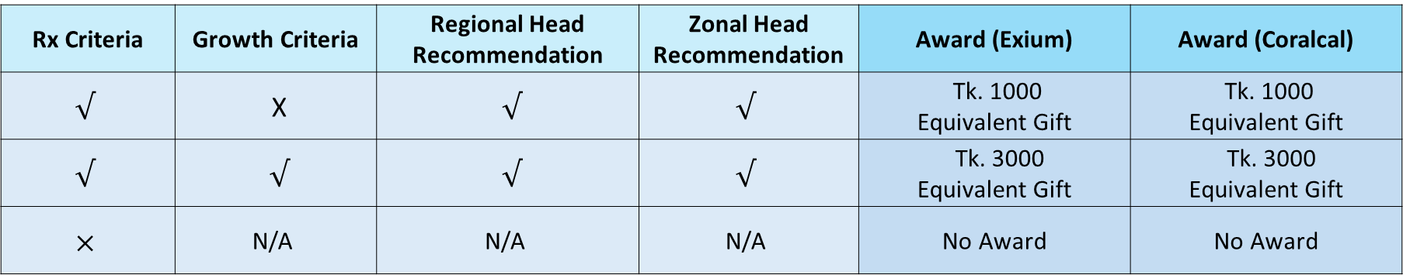
Rx & Sales Award for MIO
Brand | Month | Rx Criteria | Growth Criteria (All SKU)
Exium Exium MUPS | Sep’26 | Seen Rx At least 200/Territory | At least 30 box growth of Exium MUPS 20 mg equivalent value growth in Total Exium Brand over Aug’26
Coralcal-D Coralcal-DX Coralcal-Vita | Sep’26 | Seen Rx At least 200/Territory | At least 30 box growth of Coralcal-DX equivalent value growth in Total Coralcal Brand over Aug’26
Award:
Rx Criteria | Growth Criteria | Regional Head Recommendation | Zonal Head Recommendation | Award (Exium) | Award (Coralcal)
$√$ | X | $√$ | $√$ | Tk. 1000 Equivalent Gift | Tk. 1000 Equivalent Gift
$√$ | $√$ | $√$ | $√$ | Tk. 3000 Equivalent Gift | Tk. 3000 Equivalent Gift
$$×$$ | N/A | N/A | N/A | No Award | No Award
*Total Territory Sales must be positive over Aug’26

